Slide 1

Codes & Volts (Arduino Based Competition)
Home automation
Autometrons
SUBMITTED BY:
2001102 Saurabh Kumar MEA
2001096 Rajiv Ranjan MEA
2001104 Ankit Kumar MEA

Slide 2
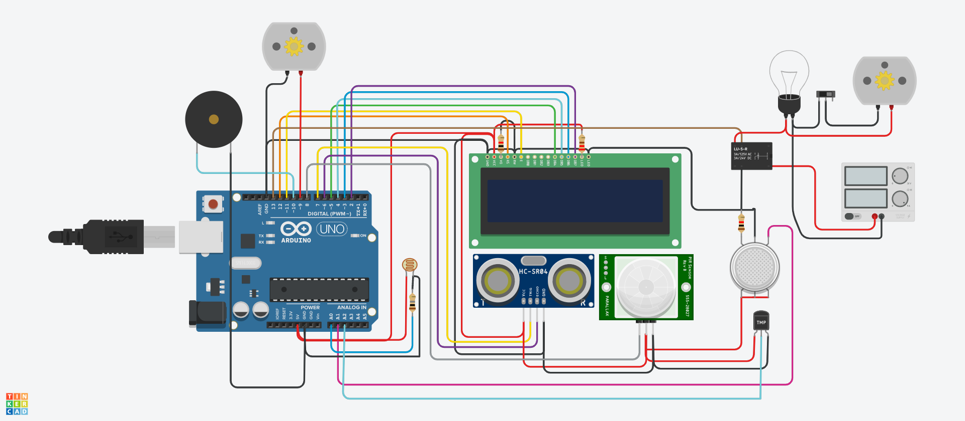
Home automation using Arduino
In this we have used multiple sensors like PIR sensor, Ping sensor, Gas sensor, Temperature sensor which all together control the lighting ,exhaust control, fire alarming etc..

Slide 3
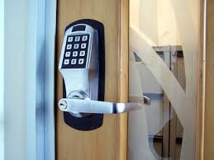
Automatic door lock
1)Often times, we need to secure a room at our home or office so that no one can access the room without our permission and ensure protection against theft or loss of our important accessories and assets.
2)There are so many types of security systems present today but behind the scene, for authentication they all relay on fingerprint, retina scanner, iris scanner, face id, tongue scanner, RFID reader, password, pin, patterns, etc. Off all the solutions the low-cost one is to use a password or pin-based system.
3)So, in this project, I have built an Arduino Keypad Door Lock which can be mounted to any of your existing doors to secure them with a digital password.

Slide 4
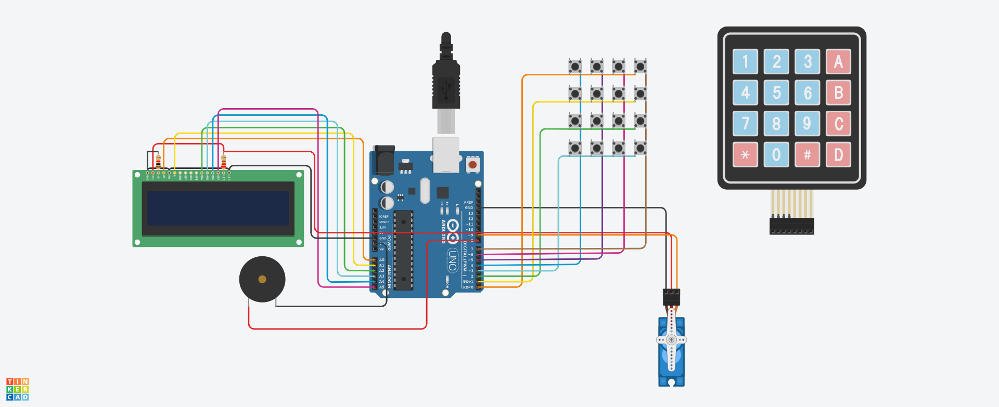
1)After booting up, it asks for the master password (in this case 1234).
2)Enter password, and it will open the lock for a few seconds before getting automatically locked.

Slide 5
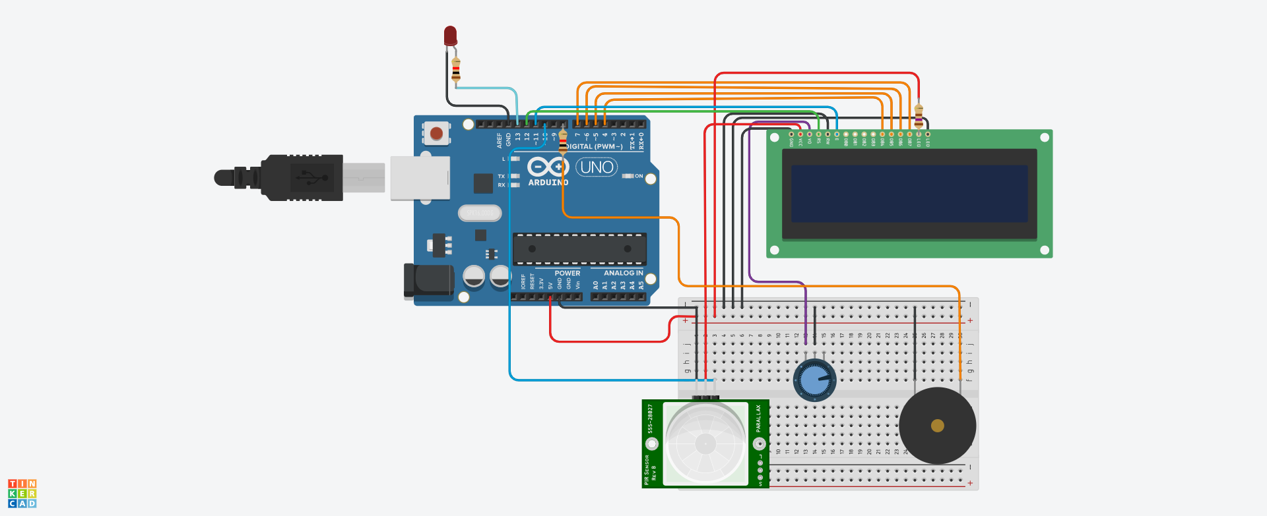
Burglar Alarm
The burglar alarm works on the use of PIR sensor(motion sensor). Whenever there is any movement in the backyard or the garden infront of the house, the PIR sensor detects it and signals through an alarm, red light and an LCD screen.

Slide 6
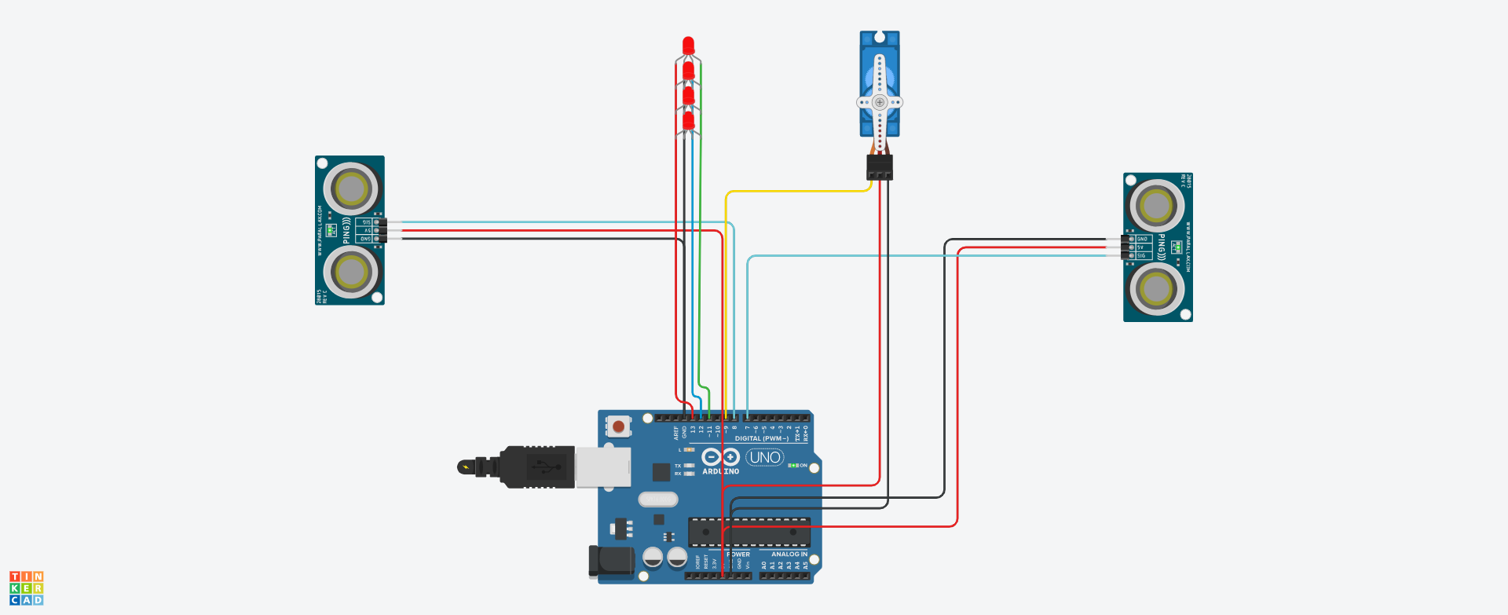
Garage Automation
In this project, we used the ultrasonic sensors to detect the arriving of a vehicle towards the garage or departure and accordingly open or close the shutter.

Slide 7
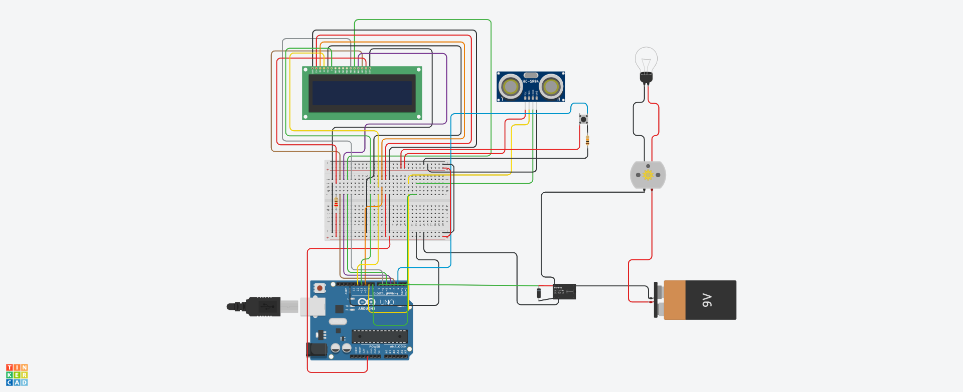
Auto Tap
In this project, We used a ping sensor to detect whether there is something below the tap and open the tap if there is.
It also closes the tap after few seconds to ensure water does not flow continuously for long.

Slide 8
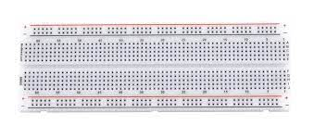
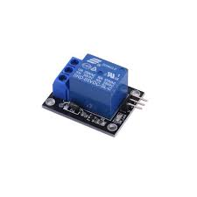
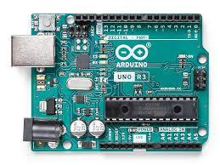
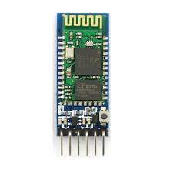
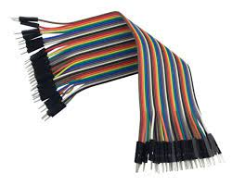
Home automation using IOT
Component required :-
Arduino
Relay
Bluetooth modular HC_05
Breadboard
Jumper wire

Slide 9
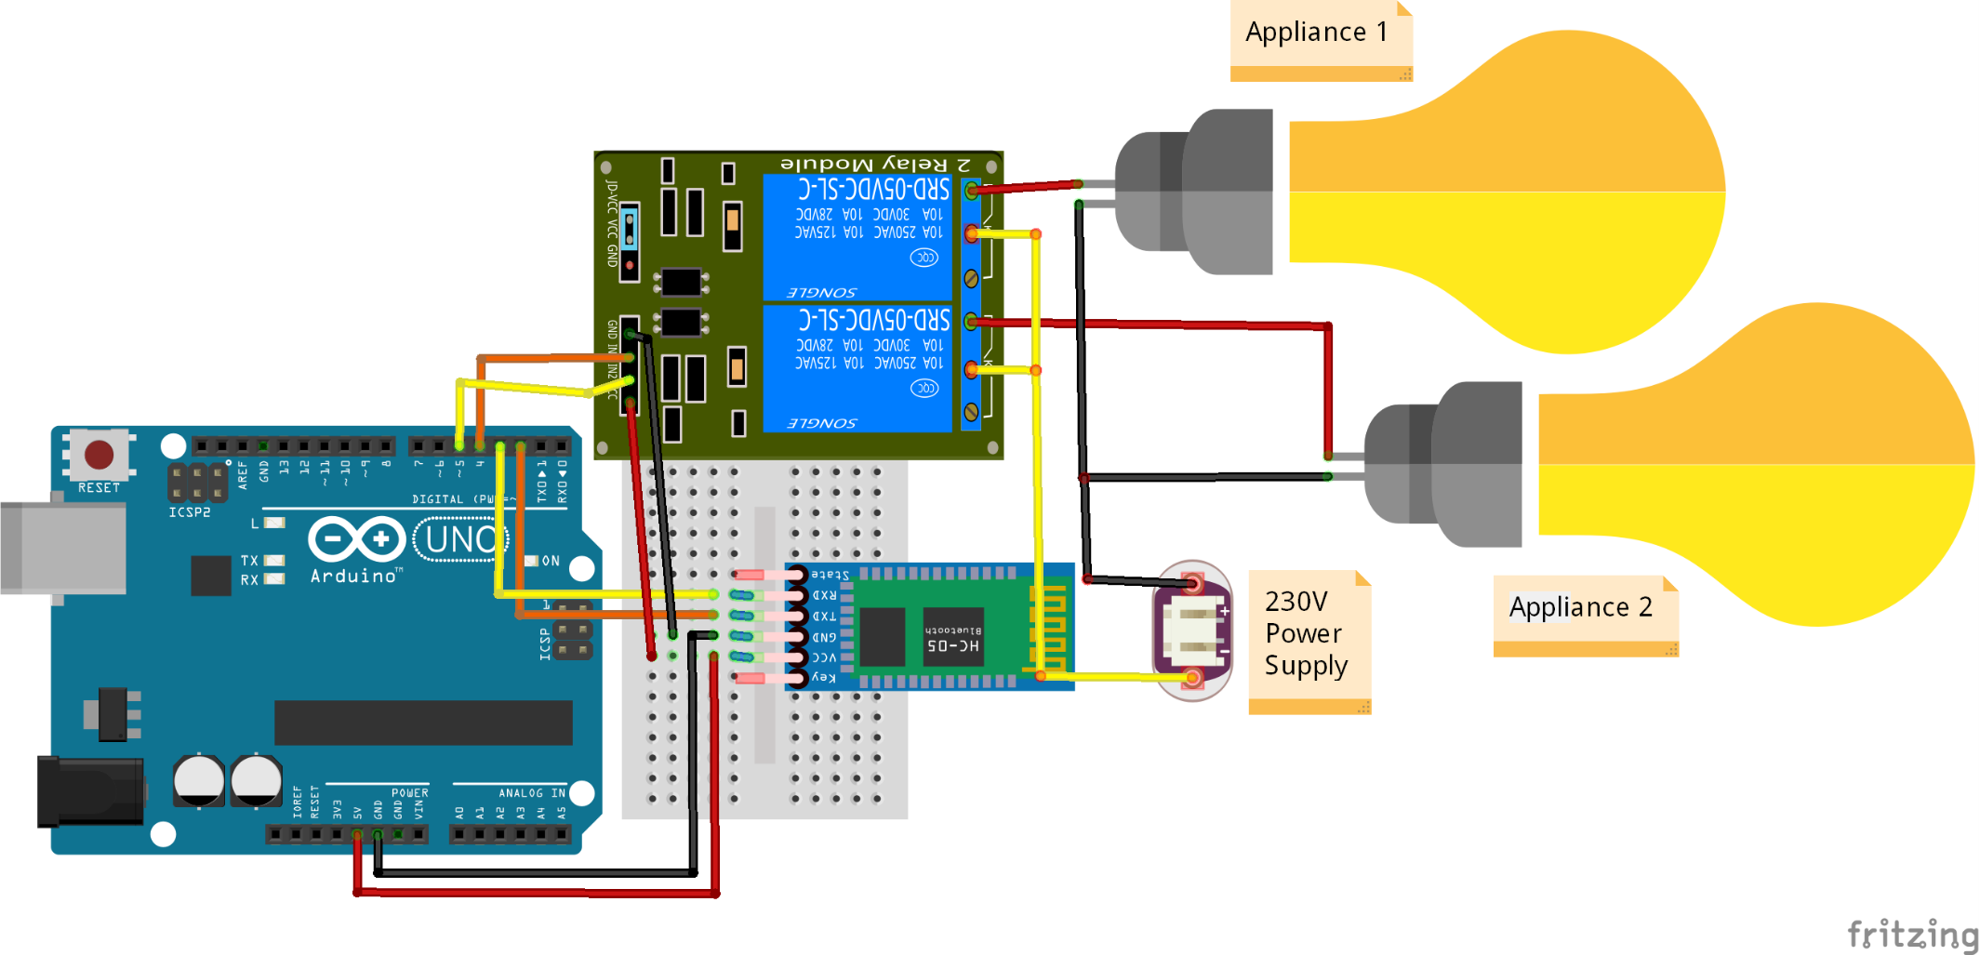
:- In Circuit diagram we have just connected 2 Channel Relay and 2 Appliances but according to code you can connect as many as you want.
Connections of Arduino and Bluetooth Module HC-05 for this Code:
* Arduino | Bluetooth Module (HC-05)
* 3 | RX
* 2 | TX
* 5V | 5V
* GND | GND

Slide 10
CODE
#include <SoftwareSerial.h> //including library for Software Serial communication
SoftwareSerial mySerial (2, 3); //(RX, TX)
//defining all the pins of Arduino
#define s1 4
#define s2 5
#define s3 6
#define s4 7
#define s5 8
#define s6 9
#define s7 10
#define s8 11
#define s9 12
void setup()
{
//setting all the pins
pinMode(s1, OUTPUT);
pinMode(s2, OUTPUT);
pinMode(s3, OUTPUT);
pinMode(s4, OUTPUT);
pinMode(s5, OUTPUT);

Slide 11
pinMode(s6, OUTPUT);
pinMode(s7, OUTPUT);
pinMode(s8, OUTPUT);
pinMode(s9, OUTPUT);
//defining baudrate
Serial.begin(9600);
mySerial.begin(9600);
}
void loop()
{
if(mySerial.available() == 1) //if communication is going on
{
char val = mySerial.read(); //Read the data recieved
Serial.println("Recieved data is " + (String) val);
if(val == 'A')
{
digitalWrite(s1, HIGH);
Serial.println("Switch 1 is ON");
}

Slide 12
if(val == 'a')
{
digitalWrite(s1, LOW);
Serial.println("Switch 1 is OFF");
}
if(val == 'B')
{
digitalWrite(s2, HIGH);
Serial.println("Switch 2 is ON");
} if(val == 'b')
{
digitalWrite(s2, LOW);
Serial.println("Switch 2 is OFF");
} if(val == 'C')
{
digitalWrite(s3, HIGH);
Serial.println("Switch 3 is ON");
}
if(val == 'c')
{
digitalWrite(s3, LOW);
Serial.println("Switch 3 is OFF"); }

Slide 13
if(val == 'D')
{
digitalWrite(s4, HIGH);
Serial.println("Switch 4 is ON");
}
if(val == 'd')
{
digitalWrite(s4, LOW);
Serial.println("Switch 4 is OFF");
}
if(val == 'E')
{
digitalWrite(s5, HIGH);
Serial.println("Switch 5 is ON");
}
if(val == 'e')
{
digitalWrite(s5, LOW);
Serial.println("Switch 5 is OFF");
}

Slide 14
if(val == 'F')
{
digitalWrite(s6, HIGH);
Serial.println("Switch 6 is ON");
} if(val == 'f')
{
digitalWrite(s6, LOW);
Serial.println("Switch 6 is OFF");
}
if(val == 'G')
{
digitalWrite(s7, HIGH);
Serial.println("Switch 7 is ON");
}
if(val == 'g')
{
digitalWrite(s7, LOW);
Serial.println("Switch 7 is OFF");
}

Slide 15
if(val == 'H')
{
digitalWrite(s8, HIGH);
Serial.println("Switch 8 is ON");
}
if(val == 'h')
{
digitalWrite(s8, LOW);
Serial.println("Switch 8 is OFF");
} if(val == 'I')
{
digitalWrite(s9, HIGH);
Serial.println("Switch 9 is ON");
}
if(val == 'i')
{
digitalWrite(s9, LOW);
Serial.println("Switch 9 is OFF");
}
}
}

Slide 16
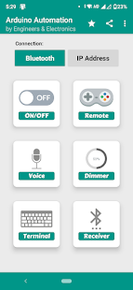
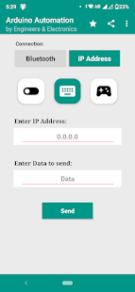
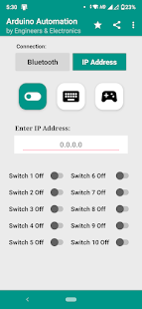
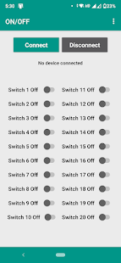
After that go to play store and download E&E: Arduino Automation app
After then connect this app with bluetooth module
And give command
If u on switch 1 then bulb 1 will glow
Similarly blub 2 will glow

Slide 17
LOGO
THANK YOU
Add your words here
www.topppt.cn

